Slide 1
ChallengeMonkey
By Team 11
Monkey See Monkey Do

Slide 2
Team Members:
Yiu Chung Yau
Karishma Muni
Joel George
Nelson Zeas
Shinan Liu

Slide 3
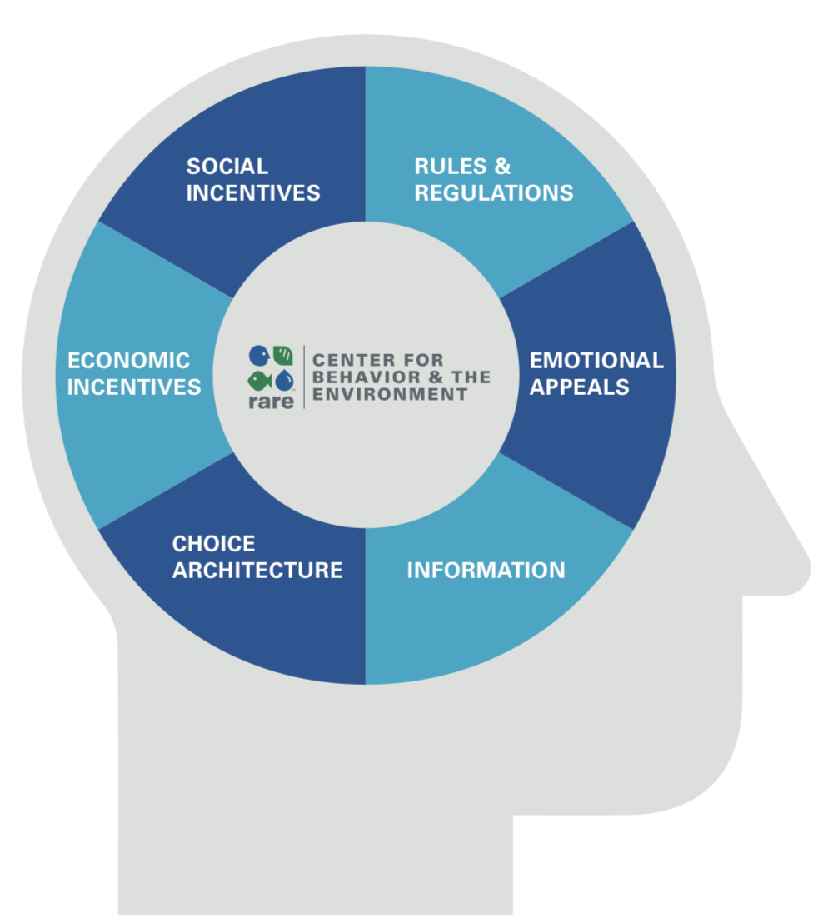
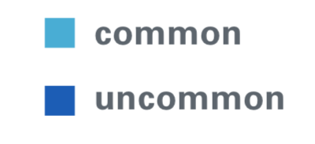
Mission of Rare
Problem to solve:
How to use technology to inspire, motivate, track and spread more positive behaviors and can help improve unpredictable climate changes.

Slide 4
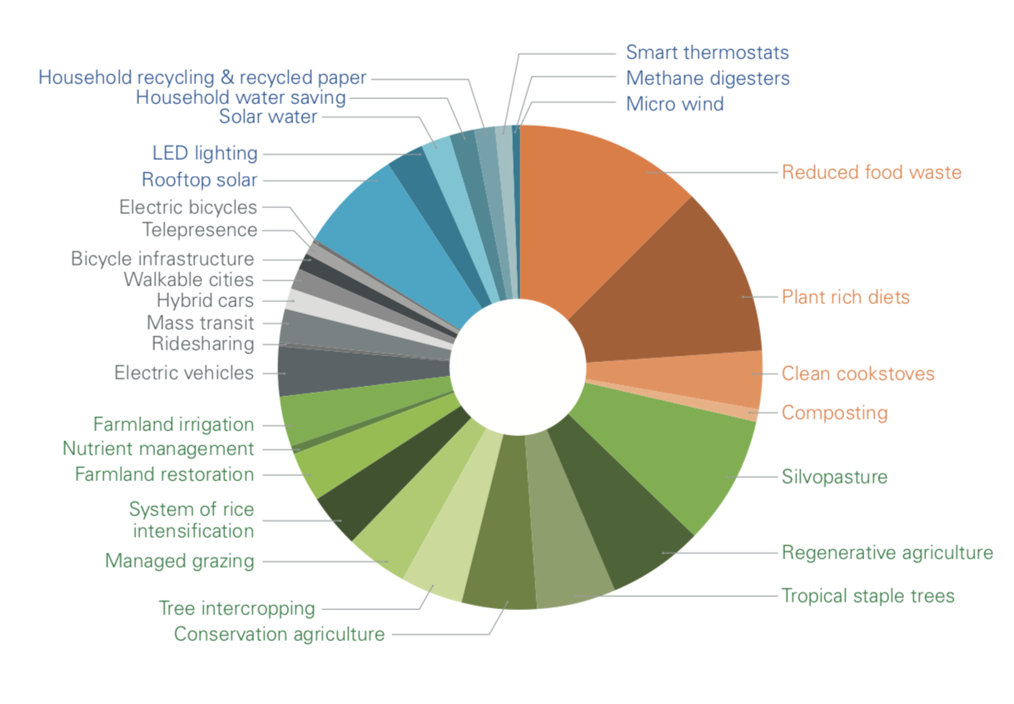
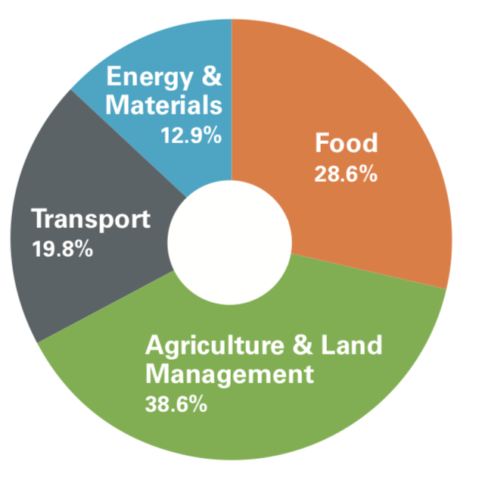

Slide 5
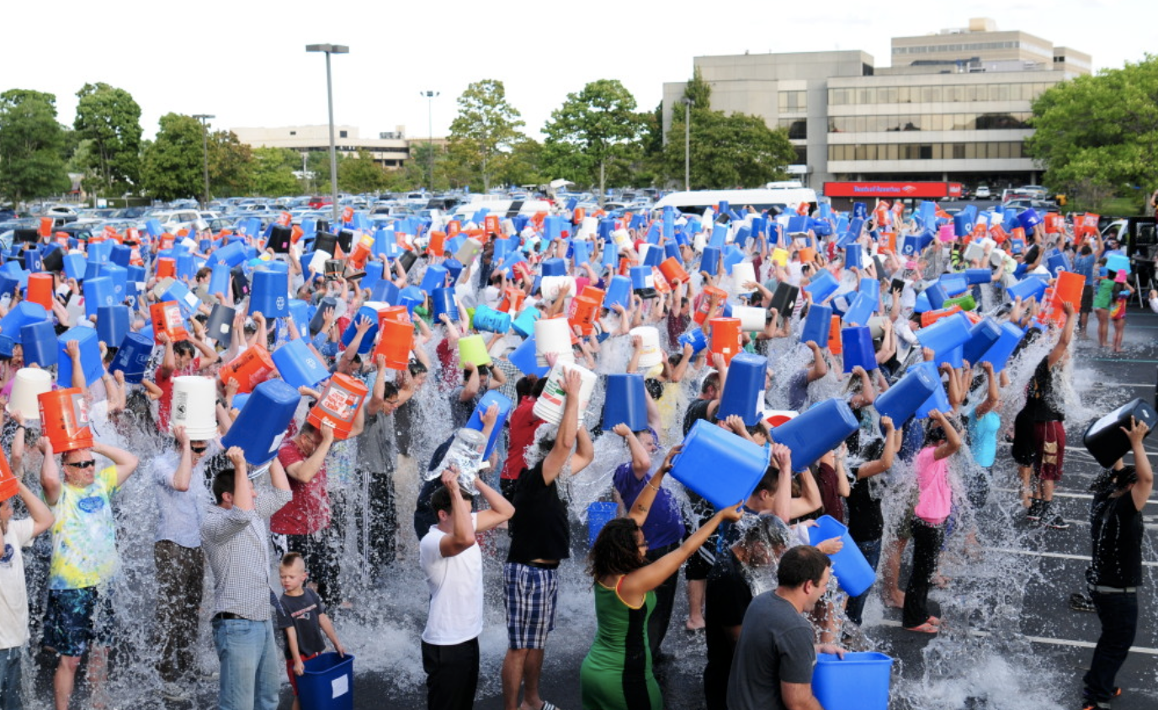
Monkey See Monkey Do!!!

Slide 6
Viral movements such as the Ice Bucket Challenge to combat ALS took social media platforms by storm.
Our Solution: A website to keep people engaged with a myriad of climate conservation movements using social influence.
Website/App: ChallengeMonkey

Slide 7
DEMO

Slide 8
Challenges/Problems:
We began our project by developing an iOS app, but ran into collaborative issues on Github.
Instead we implemented a website to perform the same tasks to which everyone could contribute.

Slide 9
Goals of the Website:
Harness the power of social media to popularize positive behavior.
Continue adding functionality such as a leaderboard, head to head competitions, and more targeted challenges.
Finish a fully functional mobile app.

Slide 10
Lessons we learned:
Communication is key
Teamwork and collaboration help the process
Combating climate change starts with changing our behavior
Don’t look at the commits leaderboard

